Slide 1

Analysis of Hospitals in India
Dinesh K

Slide 2
Hospital Beds Dataset Source - https://www.medrxiv.org/content/10.1101/2020.06.16.20132787v1.full.pdf
Hospitals Dataset Source - https://www.kaggle.com/datasets/himanshunegi2000/hospitals-in-india-dataset
Tools used- MS Excel, Tableau, PowerPoint

Slide 3
Data Cleaning
Thorough checking and data cleaning was conducted to ensure the accuracy and reliability of the dataset.
State names were made consistent.
Information for Ladakh was incomplete or missing, which was ignored during the exploration.
MS Excel was used for data cleaning.

Slide 4
Data Exploration
Data was explored to find insights on the total number of hospitals, general beds, and ICU beds in the Indian states and top 10 cities.
Tableau was used for data exploration.
Filters were applied to pick top 10 cities from data.
General beds were found by employing a calculated field which found the difference between total beds and ICU beds.

Slide 5
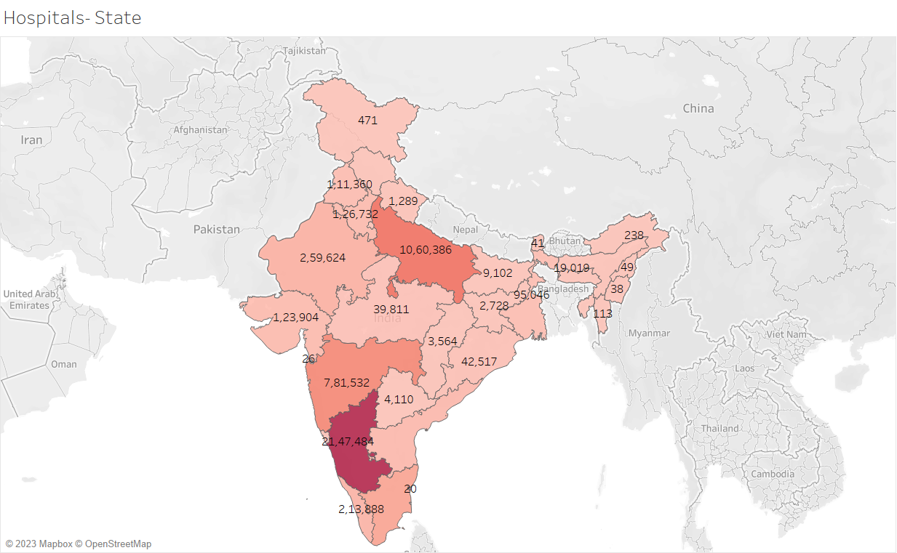
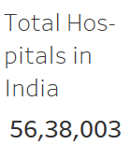
Insights - Total Hospitals
India has a total of 56 lakh hospitals.
Karnataka has the highest number of hospitals, followed by Uttar Pradesh, Maharashtra, Tamil Nadu and Rajasthan.

Slide 6
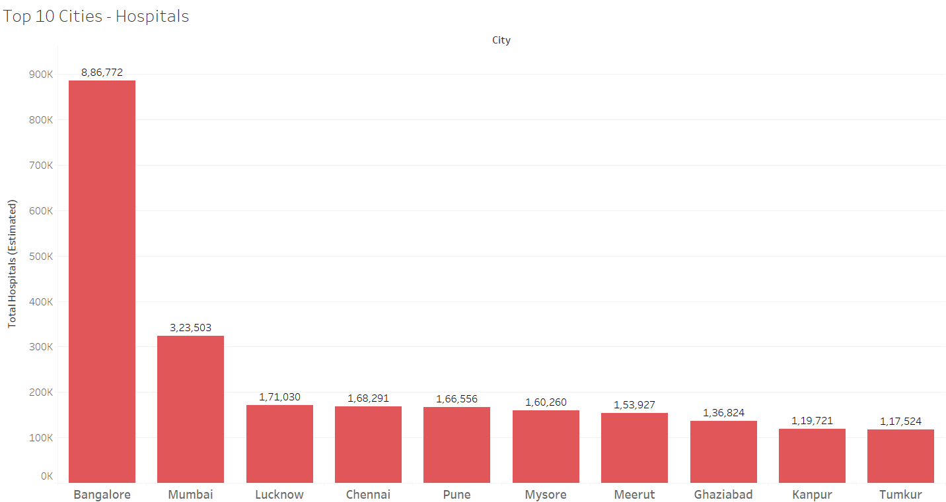
Insights - Total Hospitals in Cities
Bangalore has the highest number of hospitals, followed by Mumbai and Lucknow.
Other cities in the top 10 are Chennai, Pune, Mysore, Meerut, Ghaziabad, Kanpur and Tumkur.

Slide 7
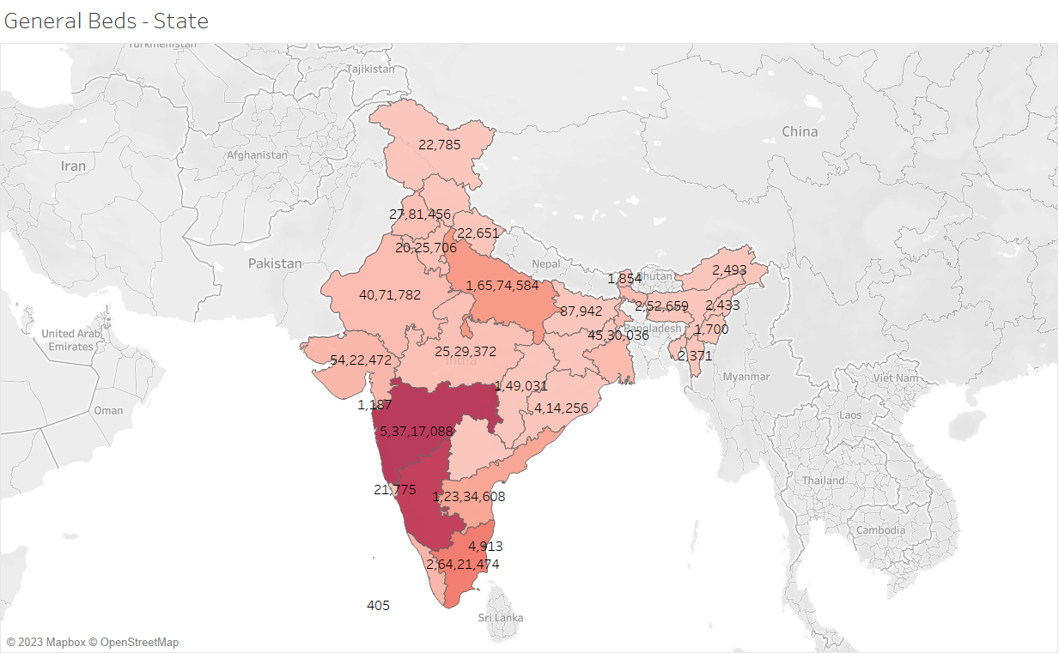
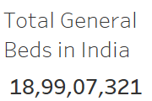
Insights - General Beds
India has a total of 18 crore general beds.
Maharashtra has the highest number of general beds, followed by Karnataka, Tamil Nadu, Uttar Pradesh and Andhra Pradesh.

Slide 8
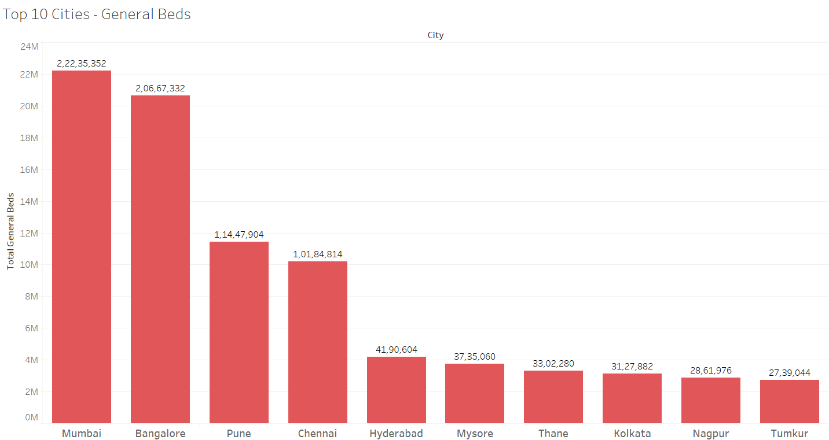
Insights - General Beds in Cities
Mumbai has the highest number of general beds, followed by Bangalore and Pune.
Other cities in the top 10 are Chennai, Hyderabad, Mysore, Thane, Kolkata, Nagpur and Tumkur.

Slide 9
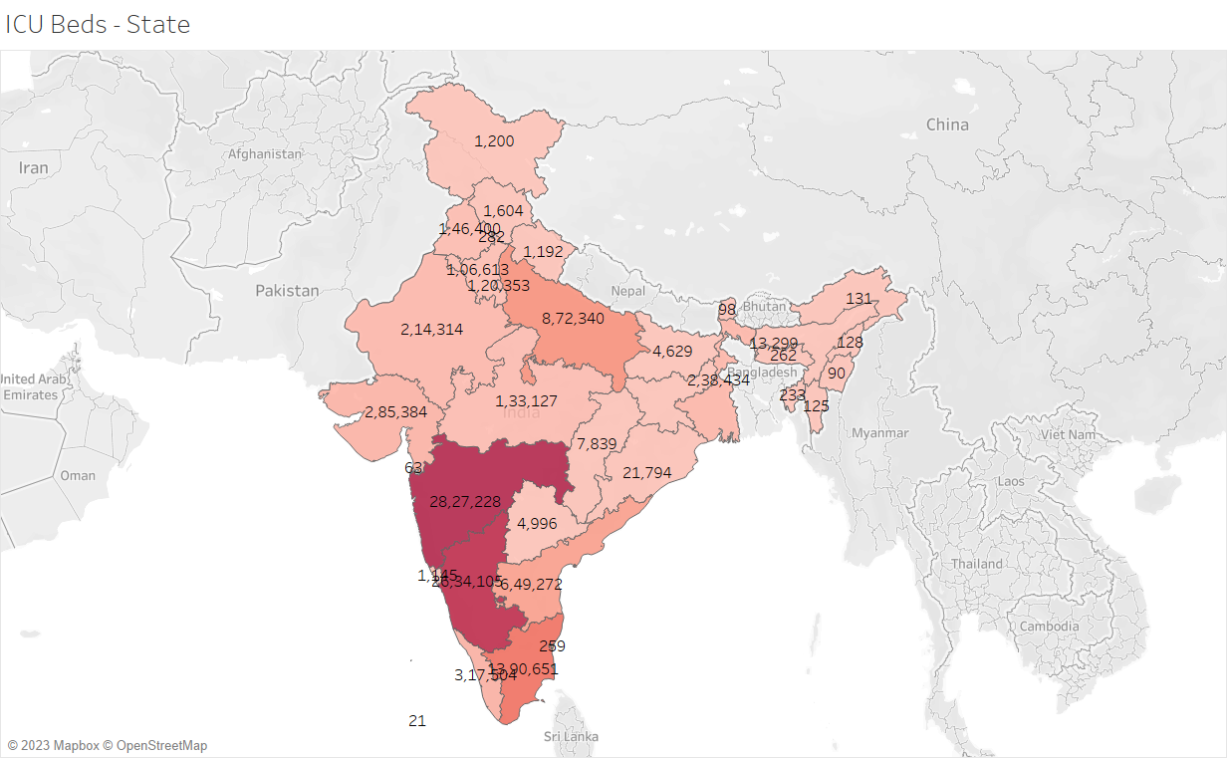
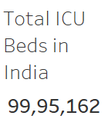
Insights – ICU Beds
India has close to 1 crore ICU beds.
Maharashtra has the highest number of ICU beds, followed by Karnataka, Tamil Nadu, Uttar Pradesh and Andhra Pradesh.

Slide 10
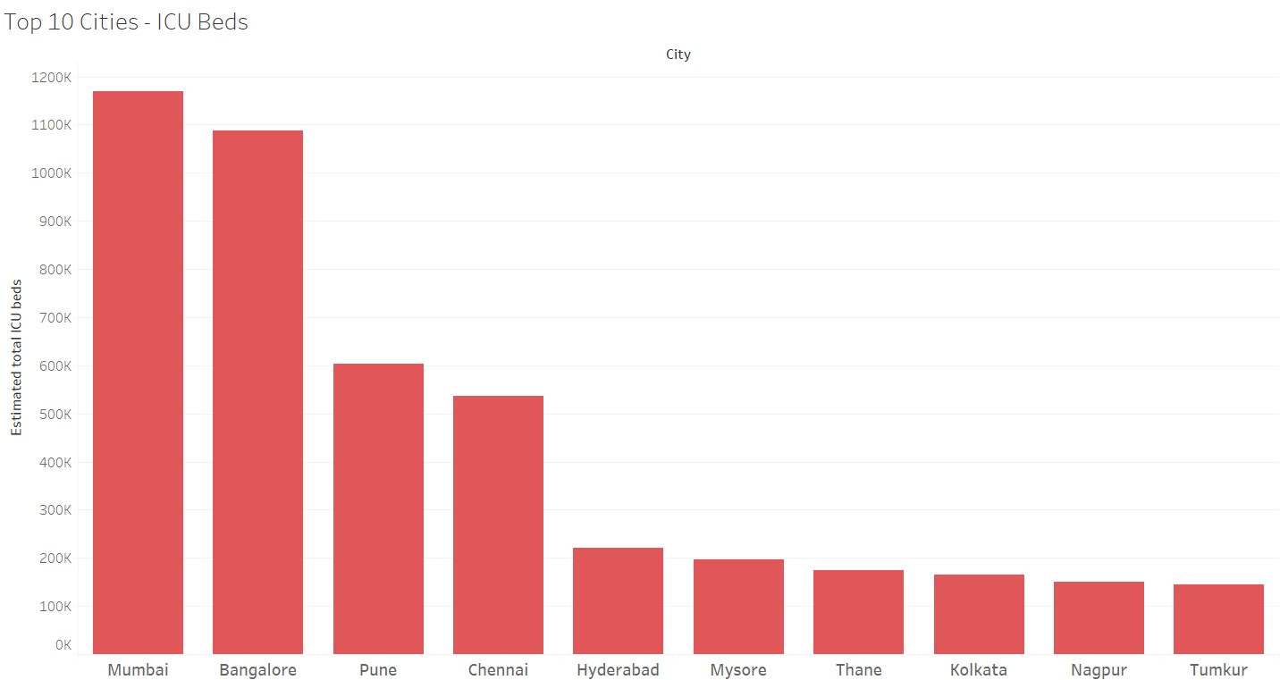
Insights - ICU Beds in Cities
Mumbai has the highest number of ICU beds, followed by Bangalore and Pune.
Other cities in the top 10 are Chennai, Hyderabad, Mysore, Thane, Kolkata, Nagpur and Tumkur.

Slide 11
Insights Summary
States
Karnataka has the highest number of hospitals, followed by Uttar Pradesh, Maharashtra, Tamil Nadu and Rajasthan.
Maharashtra has the highest number of general beds and ICU beds followed by Karnataka, Tamil Nadu, Uttar Pradesh and Andhra Pradesh.
Cities
Bangalore has the highest number of hospitals, followed by Mumbai and Lucknow.
Mumbai has the highest number of general beds, followed by Bangalore and Pune.
Mumbai has the highest number of ICU beds, followed by Bangalore and Pune.

Slide 12
Conclusion
This project's significance lies in providing valuable insights into the distribution of hospitals, general beds, and ICU beds across India.
These findings can support decision-making processes in healthcare planning and resource allocation.
Overall, this project demonstrates my ability to analyze and visualize healthcare data to derive meaningful insights.

